Slide 1


Telecom Customer Churn Analysis Using Big Data Engineering
BD Course
G6
Notes:
Note:
1

Slide 2



Our Team
Nada Mahmoud
Roma Magdy
Omar Khaled
Samsung Innovation Campus
Notes:
Note:
2

Slide 3
Introduction
Our project builds a full telecom data pipeline that takes raw data, processes it, and turns it into KPIs.
The goal is to show how real telecom data moves through a modern data stack and how we can turn it into insights for better decisions.
Samsung Innovation Campus
Notes:
Note:
4

Slide 4
Problem Statement
Telecom companies face three main challenges:
High churn
Scattered data
Missing KPIs
Our goal: build a data pipeline that brings everything together and delivers clear KPIs and dashboards.
Samsung Innovation Campus
Notes:
Note:
6

Slide 5
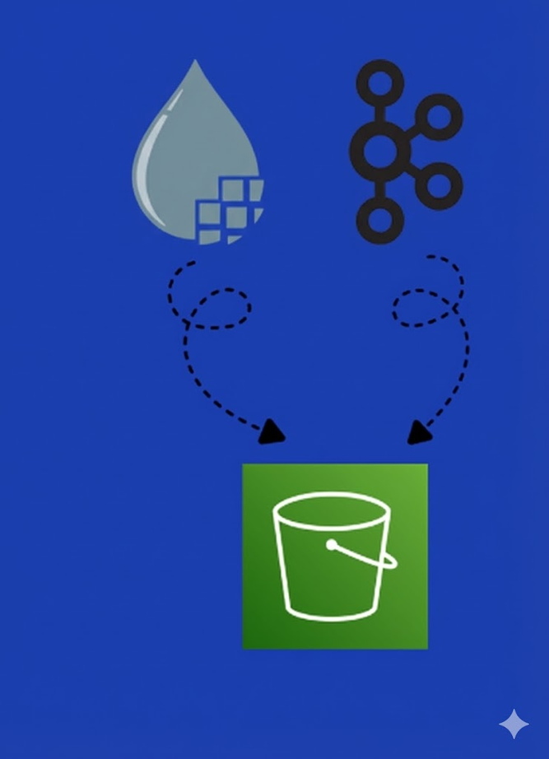






Architecture - Big Picture
Nifi
S3
AWS Glue
Athena
Power BI
Kafka
Samsung Innovation Campus
Notes:
Note:
6

Slide 6



Data Ingestion
1- Batch Data Ingestion Flow
Batch data generator
Spool Directory
ListFile
S3
PutS3Object
FetchFile
raw/batch/

Slide 7
Data Ingestion
2- Batch Data Ingestion Flow
ConsumeKafkaRecord
Nifi
S3
Stream data generator
Kafka Topic
raw/stream/
PutS3Object

Slide 8

Transformation
S3
Glue ETL
S3
raw/batch/
Processed/batch/
raw/stream/
Processed/stream/

Slide 9




Loading & Analysis
Glue Data Catalog
Powerbi
S3
Glue ETL
Athena
Processed/batch/
Processed/stream/
Glue Crawler Job

Slide 10
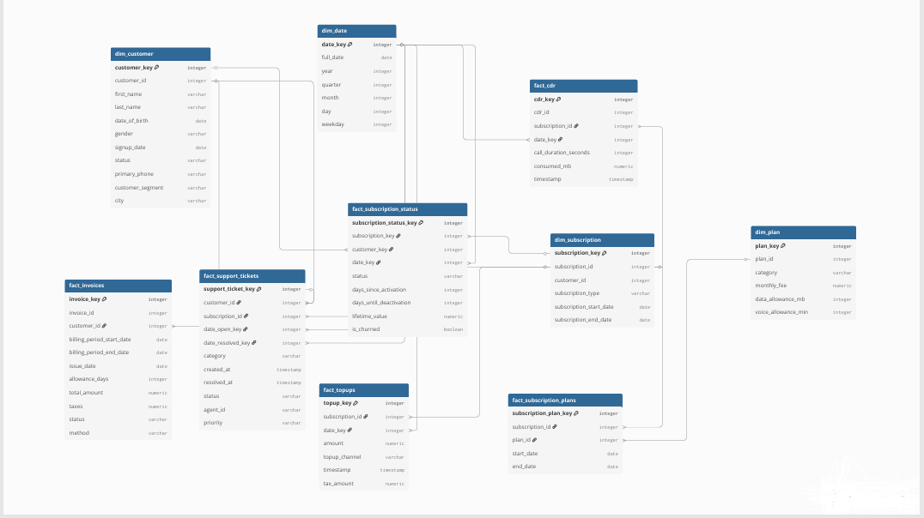
Galaxy Model Design
Samsung Innovation Campus
Notes:
Note:
2

Slide 11
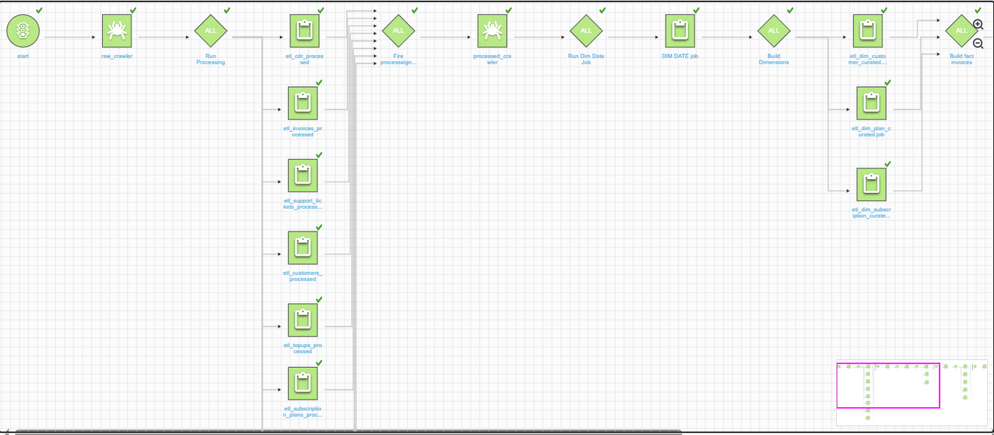
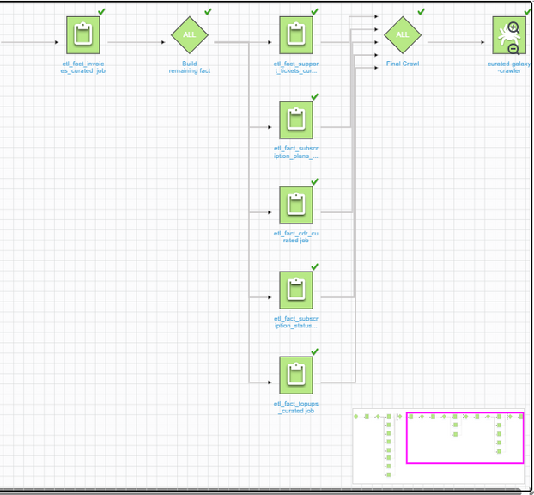
Orchestration
AWS Glue Workflows (Orchestrator)

Slide 12
Kpis & Analysis
ARPU by segment: AVG revenue per user for each segment
ARPU per customer month: AVG monthly revenue per customer
churn by plan: lost users by plan
churn rate per year: annual customer loss rate
usage_per_customer_month: monthly usage per customer
rfm_per_month: monthly recency-frequency-monetary value

Slide 13
Kpis & Analysis
CLV: total projected customer revenue
early_warning_signals: indicators of future churn based on usage, topups, support tickets
escalation_rate_per_month: monthly support escalation rate
heavy_users: customers with high usage
high_frequency_topups: frequent balance recharges
low_usage_users: customers with minimal usage

Slide 14
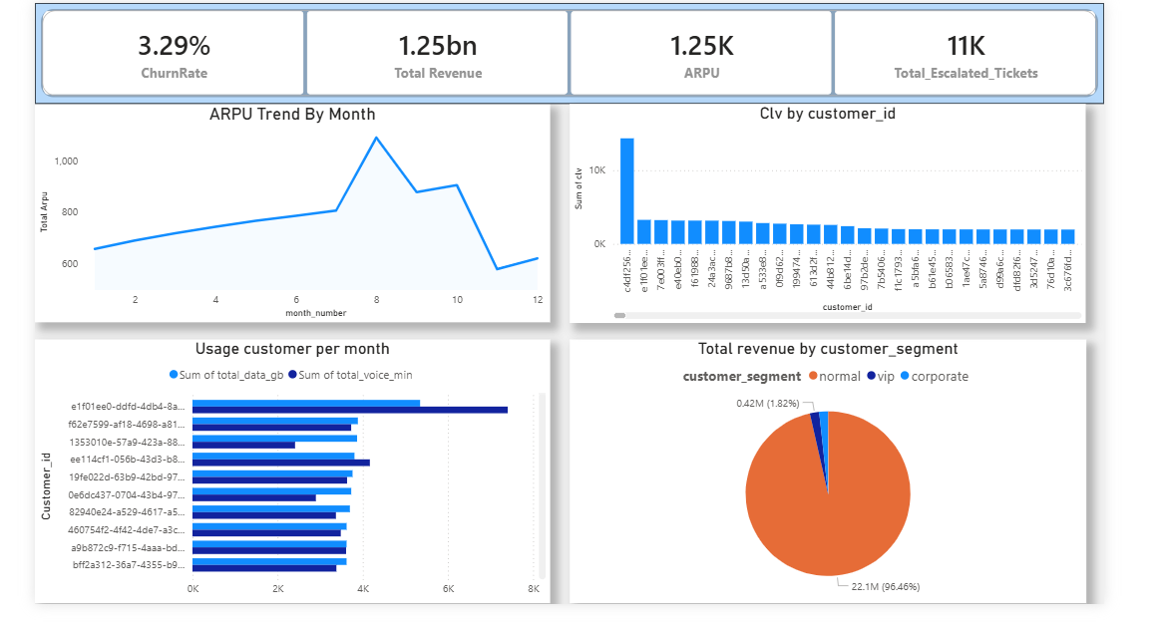
Results and insights

Slide 15
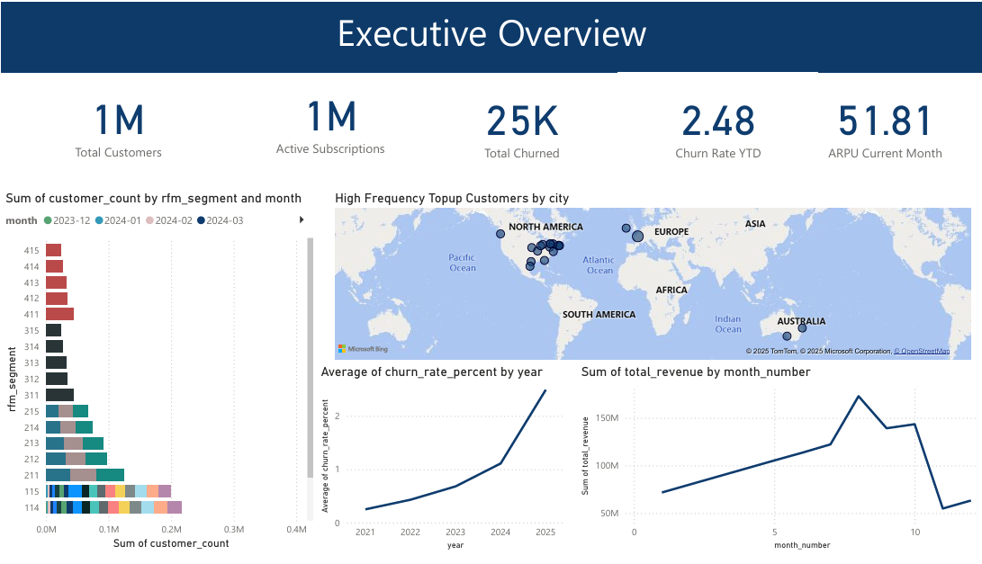
Results and insights

Slide 16
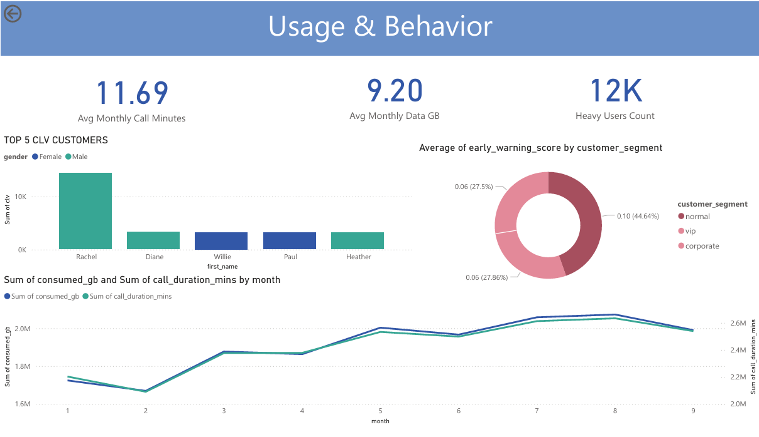
Results and insights

Slide 17
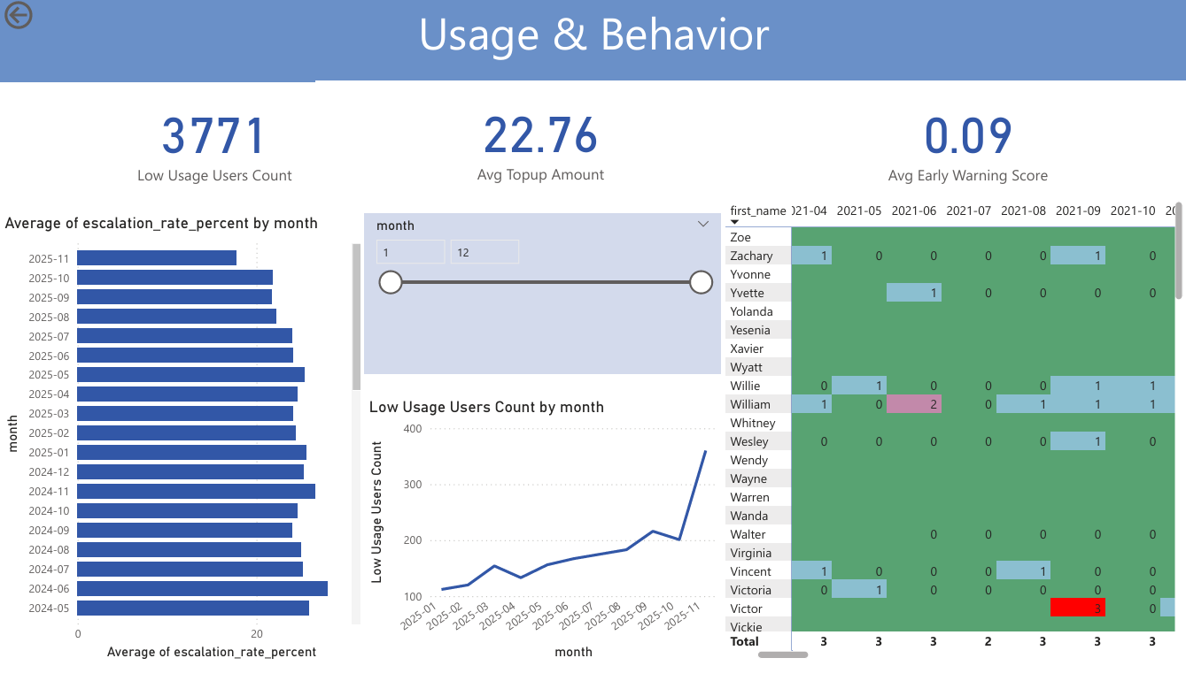
Results and insights

Slide 18
Recommendation
load the integrated datasets into Amazon Redshift
Strengthen Customer Service with a 360° Customer View
Integrate Network Performance into Customer Insights
Samsung Innovation Campus
Notes:
Note:
4

Slide 19

ⓒ2020 SAMSUNG. All rights reserved.
Samsung Electronics Corporate Citizenship Office holds the copyright of book.
This book is a literary property protected by copyright law so reprint and reproduction without permission are prohibited.
To use this book other than the curriculum of Samsung innovation Campus or to use the entire or part of this book, you must receive written consent from copyright holder.
Notes:
10

